Slide 1
14.05.2025
NATIONAL UNIVERSITY OF SINGAPORE
GROUP 17
SURYAANSH RATHINAM(A0307215N)
SNEHA SARKAR (A0304787U)
BHUSHAN MOHOL (A0304884X)
TAN ZHIQIANG (A0290862X)
NI SHINAN (A0304558B)
HATE DETECTION CS5344 BIG DATA PROJECT
Presentation Recording Link

Slide 2
NATIONAL UNIVERSITY OF SINGAPORE
TABLE OF CONTENTS
14.05.2025
THE DATASET
CHALLENGES
PIPELINE
DATA PREPROCESSING
DATA AUGMENTATION
MODELS
EVALUATION & RESULTS
COMPARISON - Text vs MultiModal
DEMO
CONCLUSION

Slide 3
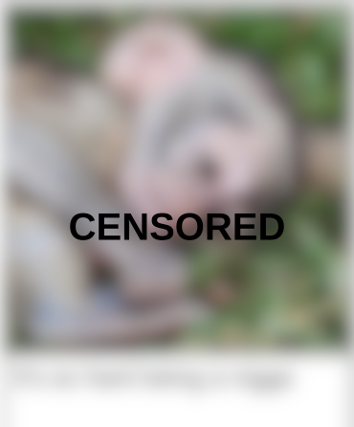


14.05.2025
THE DATASET
NATIONAL UNIVERSITY OF SINGAPORE
The MMHS150K dataset (reference link)is a significant resource for multimodal hate speech detection.
Comprising around 150,000 image-text pairs from social media, it offers fine-grained labels for different categories of hate speech, including racism, sexism, and homophobia.
This dataset enables the development of models that can understand and reason across both visual and textual modalities to identify harmful content.
Notes:
Explain dataset was crowd sourced annotated.

Slide 4
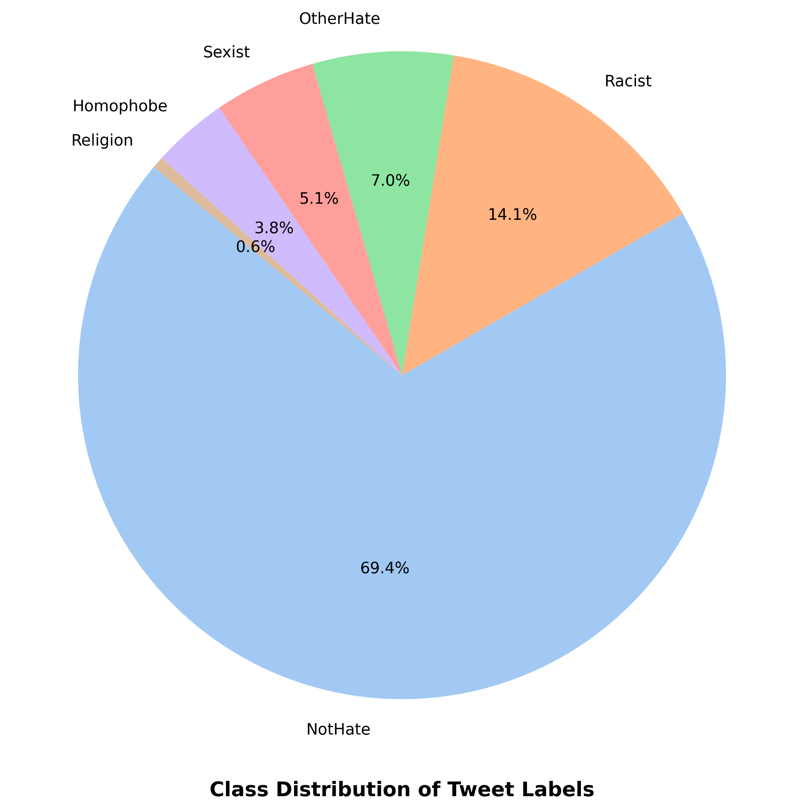
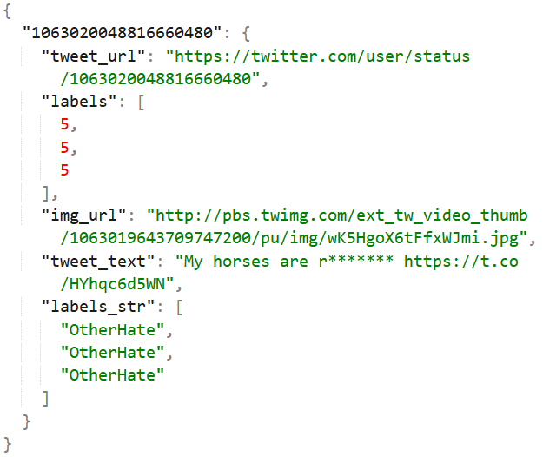
14.05.2025
DATASET ANALYSIS (VISUALISED)
NATIONAL UNIVERSITY OF SINGAPORE
The labelled dataset consists of 6 labels - ‘NotHate’, ‘Religion’, ‘Homophobe’, ‘Sexist’, ‘OtherHate’ and ‘Racist’. Every record consists of the tweet text and a link to the tweet image
Notes:
Image 1 - Class distribution - Can be used to explain class imbalance

Slide 5
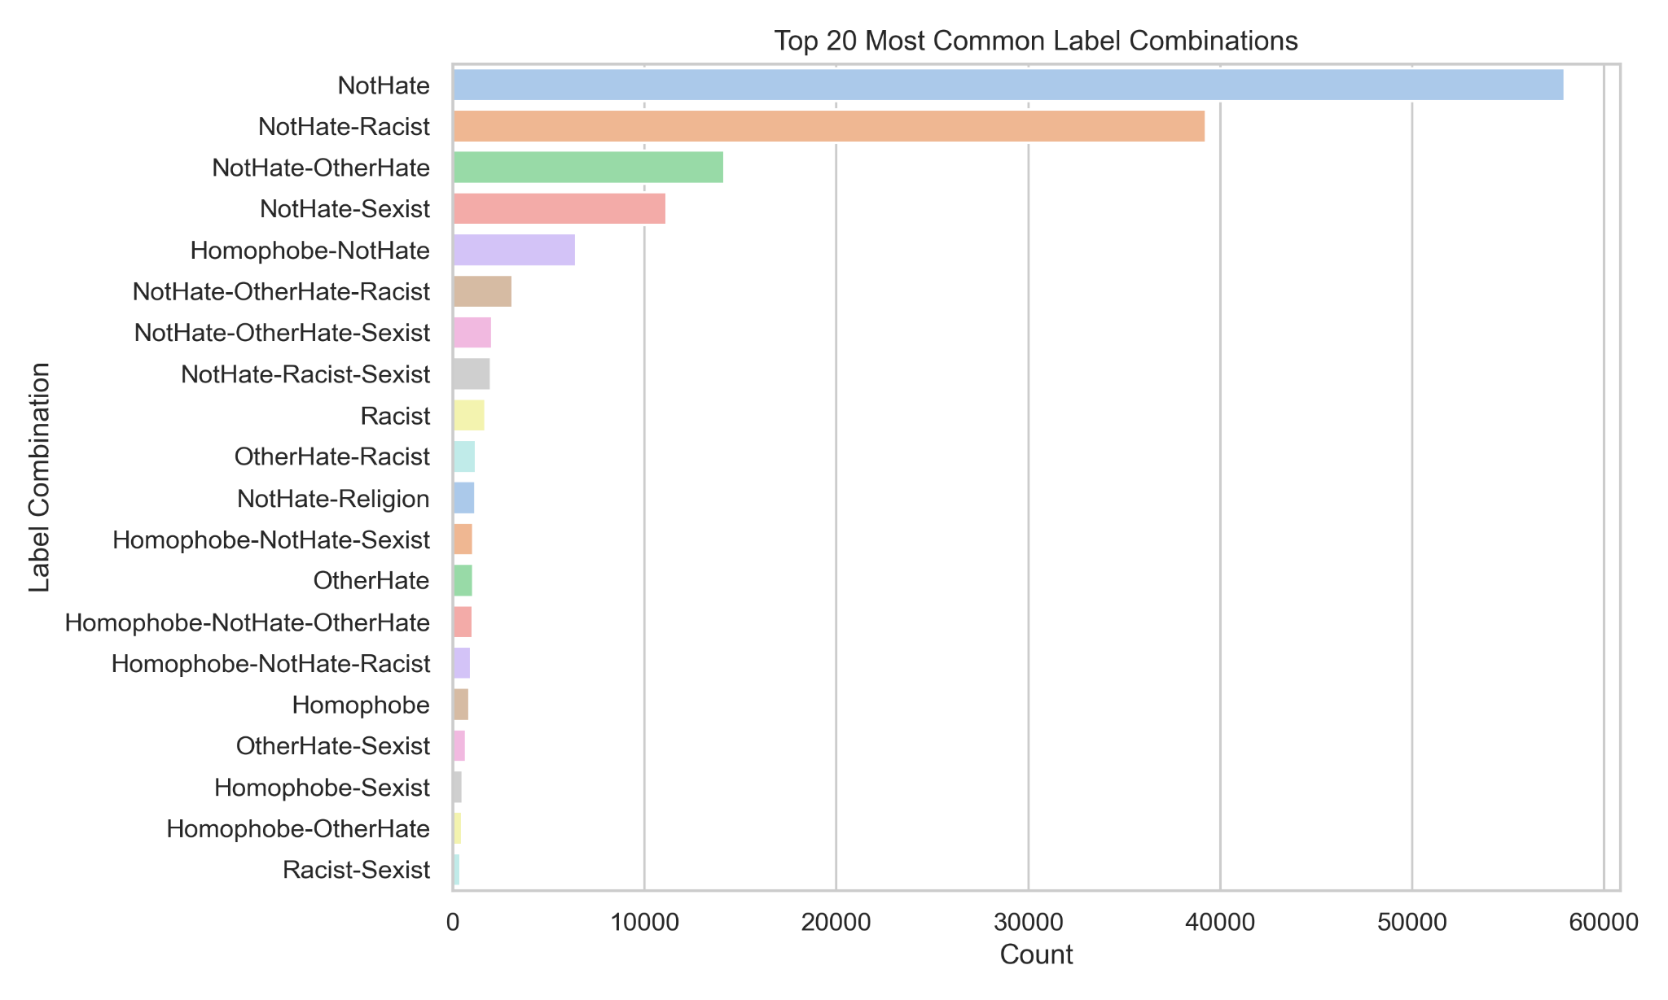
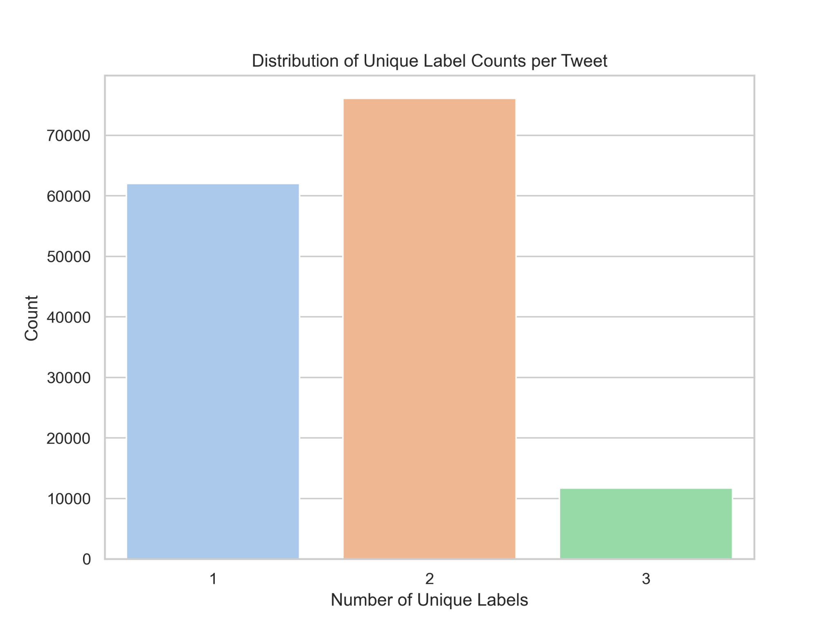
14.05.2025
NATIONAL UNIVERSITY OF SINGAPORE
DATASET ANALYSIS (VISUALISED)
Every record consists of a tuple with 3 labels, each labelled by 3 different workers.
Example - [“Racist”, “Racist”, “Religion”]
Notes:
Image 1 - common label combinations - Can be used to explain ‘Subjectivity in labels’ challenge

Slide 6
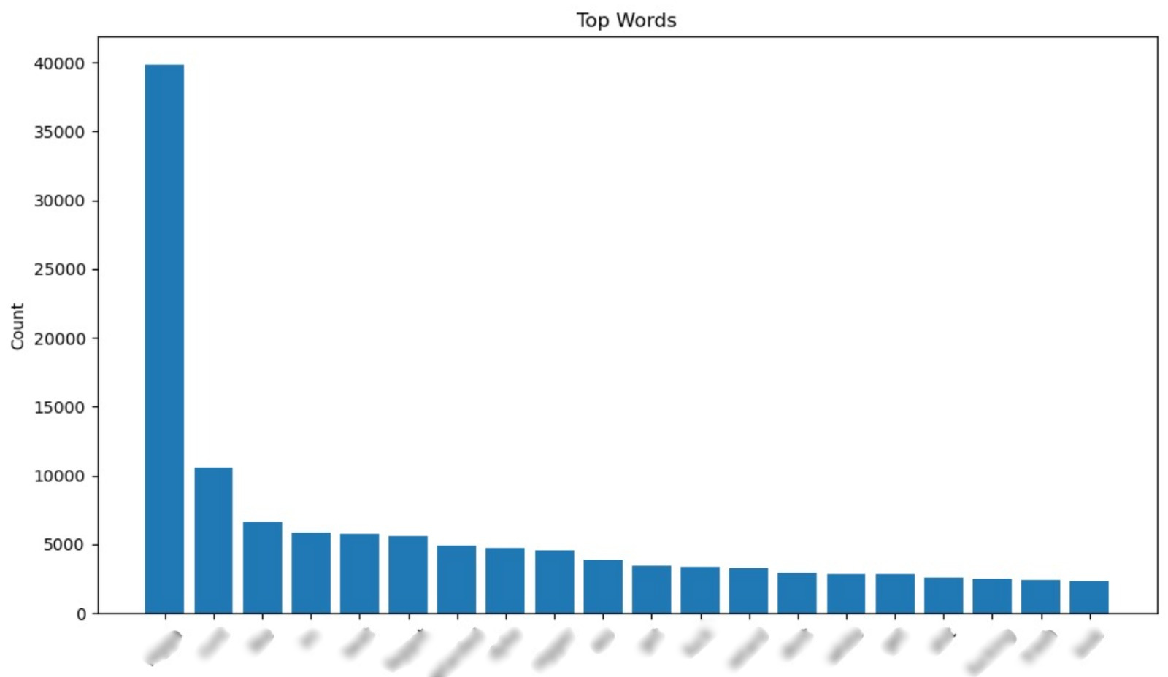
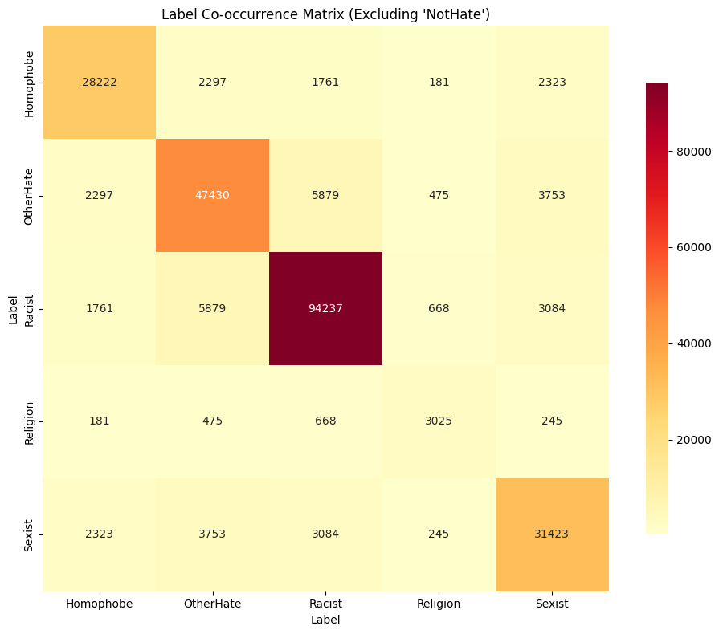
14.05.2025
NATIONAL UNIVERSITY OF SINGAPORE
DATASET ANALYSIS (VISUALISED)
Distribution of Most Frequent Words used in Tweets Belonging to the ‘Hate’ Class
Confusion Matrix of Hate Words Categories
Notes:
Image 1 - common label combinations - Can be used to explain ‘Subjectivity in labels’ challenge

Slide 7
14.05.2025
NATIONAL UNIVERSITY OF SINGAPORE
CHALLENGES
Limited PySpark MLlib:
PySpark MLlib primarily offers simple machine learning algorithms (e.g., Logistic Regression, Decision Trees, Random Forests).
Lacks support for complex deep learning architectures like ResNet50 and LSTMs.
Prevents direct learning on image data within PySpark MLlib.
Large Dataset Processing: The dataset's large size makes direct processing challenging.
Batch Training Necessity: Due to the dataset size, training must be done in batches.
Dataset Imbalance: The significant class imbalance in the dataset complicates analysis and prediction.
Subjectivity in Labels: Manual human labeling introduces subjectivity, leading to potential inaccuracies in some labels.
Model Constraints: Common powerful image processing models (like ResNet) were not directly usable. We had to look into creating and modifying smaller models to achieve good accuracy.

Slide 8
14.05.2025
NATIONAL UNIVERSITY OF SINGAPORE
PIPELINE
Train Set
Model
Data PreProcessing
Shuffling
DataSet
Efficient
Net
BiLSTM
Evaluation
Validate Set
MobileNetV2
RoBERTa
Test Set
Label Encoding
Do augmentation on text dataset and image dataset
A fusion Model combining text branch and image branch
Cleaning
Tokenization

Slide 9
14.05.2025
NATIONAL UNIVERSITY OF SINGAPORE
DATA PREPROCESSING
Label Transformation
Applied majority voting over multiple labels
Converted multiclass labels to binary format based on majority voting:
0 → NotHate
1 → Hate (Racist, Sexist, Homophobe, Religion, OtherHate)
Cleaned Tweet Texts
Lowercase all text
Removed URLs, mentions, hashtags, numbers, punctuation
Tokenization and Transformation
Used Hugging Face BERT tokenizer (bert-base-uncased)
Transformed text using tokenization with padding + truncation

Slide 10
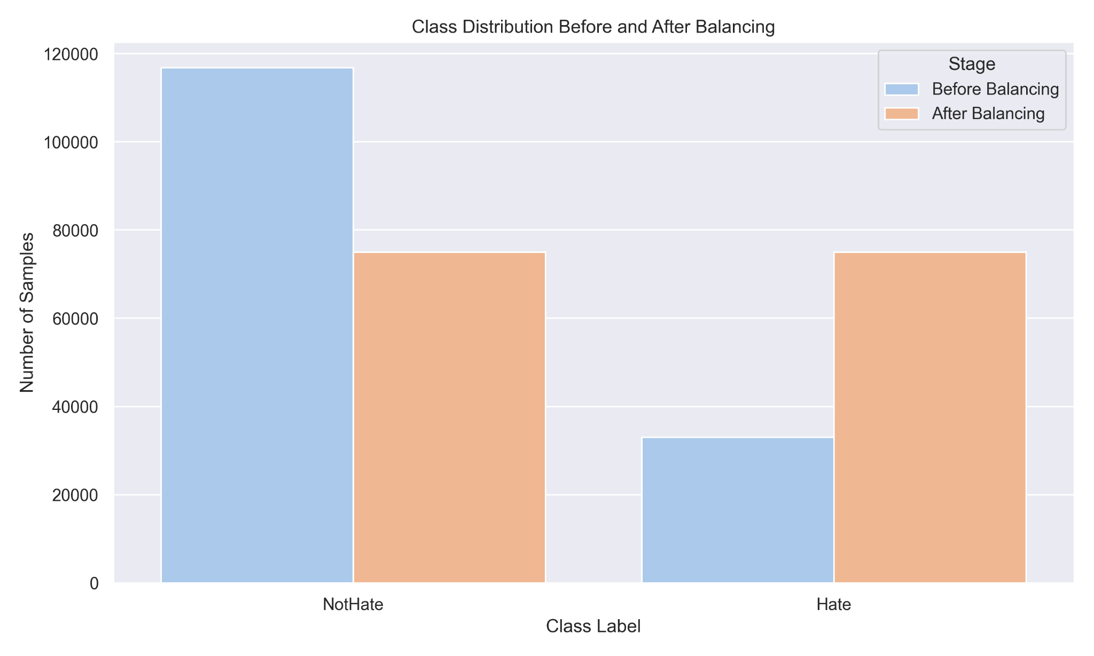
14.05.2025
NATIONAL UNIVERSITY OF SINGAPORE
DATA AUGMENTATION
Text Augmentation for Hate Class: Applied 2 random techniques per record)
Synonym Replacement (via WordNet)
Random Deletion (word-level dropout)
Random Swap (shuffle words)
Image Augmentation for Hate Class: Applied 1 random technique using torchvision:
Rotation
Brightness jitter
Horizontal/vertical flips
Balancing the Dataset
NotHate: Undersampled to 75,000 samples
Hate: Oversampled to 75,000 samples using both text and image augmentation

Slide 11
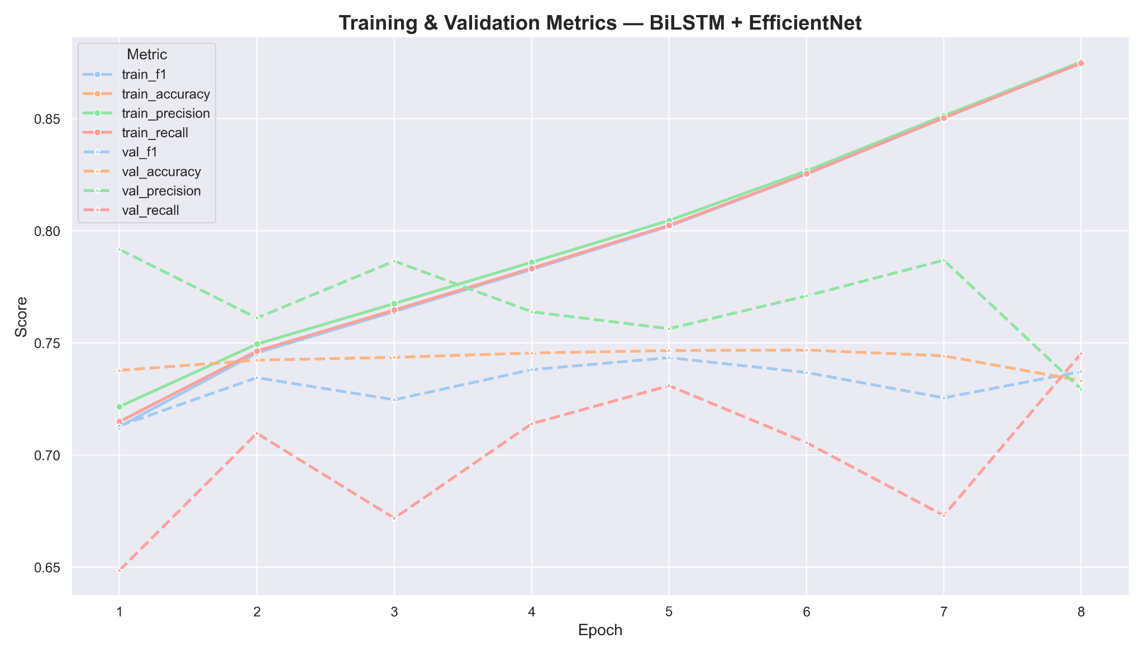
14.05.2025
NATIONAL UNIVERSITY OF SINGAPORE
MODELS - EfficientNet + BiLSTM
Image Branch
Uses EfficientNet-B0 as a feature extractor.
Final 1280-dim features are passed through a dense layer to get 256-dim image embeddings.
Text Branch
Uses a custom embedding layer initialized from the HuggingFace bert-based tokenizer.
Followed by a Bidirectional LSTM to capture contextual information → Outputs a 128-dim text representation after dense layers
Fusion Layer
Concatenates image and text features (256 + 128)
Passes through fully connected layers to output a single logit for binary classification
Notes:
We wanted to experiment with models trained locally, ones that could give us good results despite the vast amount of data in limited resources. Because in the real world we’d like to deploy solutions that work well with lesser compute, lesser carbon footprint etc.
So here we’ve displayed the models that performed the best.
Both models are trained in batches.
Employ early stopping with a patience of 3.

Slide 12
14.05.2025
NATIONAL UNIVERSITY OF SINGAPORE
MODELS - MobileNetV2 + RoBERTa
Image Branch (MobileNetV2):
A lightweight CNN pre-trained on ImageNet.
Extracts 256-dimensional visual features from tweet images.
Training final layers to reduce compute and overfitting.
Text Branch (RoBERTa):
Based on reference.
Fine-tuned for hate detection on Twitter data.
Extracts 256-dimensional textual embeddings.
Also training final layers to reduce compute and overfitting..
Fusion Strategy: Combines image and text embeddings using a weighted average:
The alpha value is tuned via grid search to find the optimal modality balance.
Final Classifier: A fully connected layer predicts the binary class (Hate / Not Hate).
Notes:
Inspired by elastic net that combines L1 & L2 regularization

Slide 13
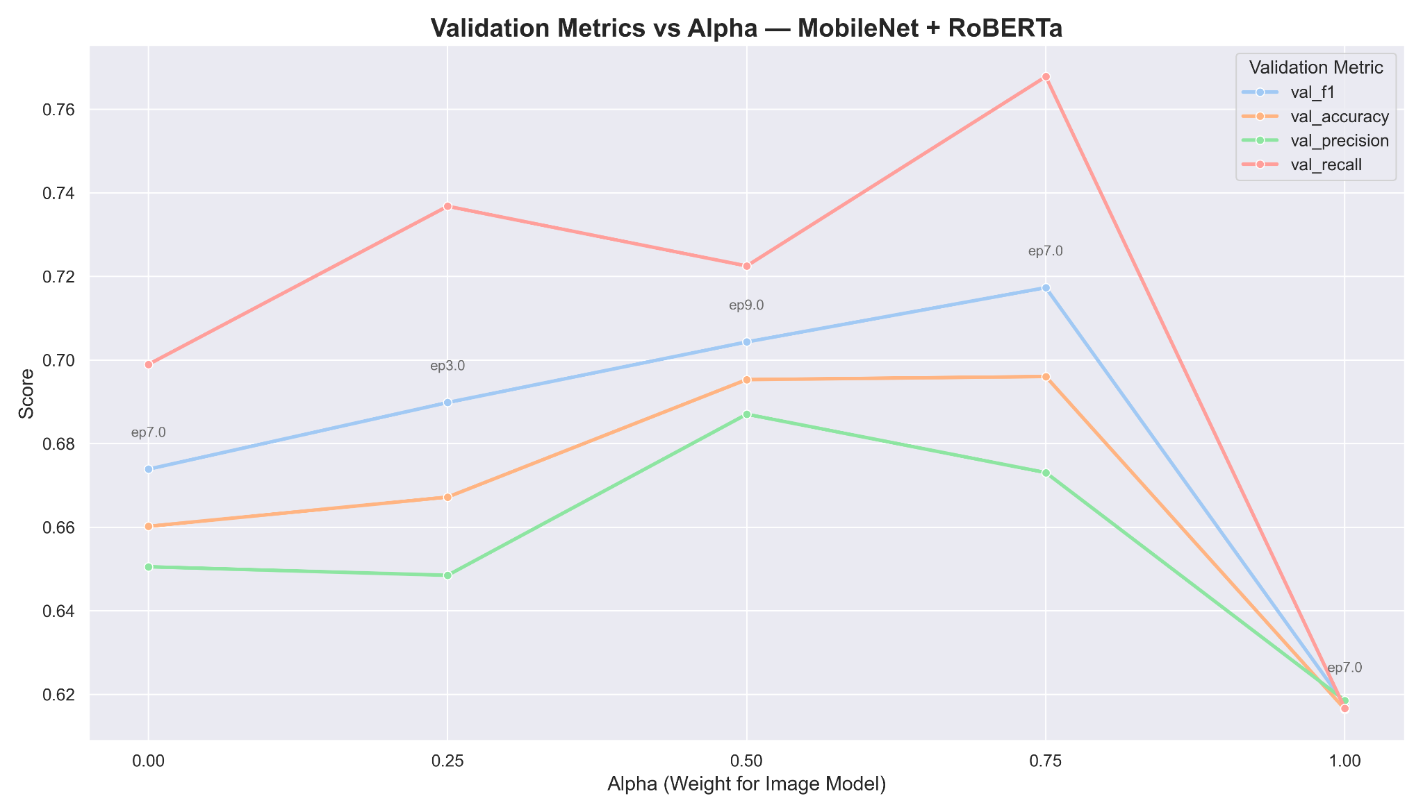
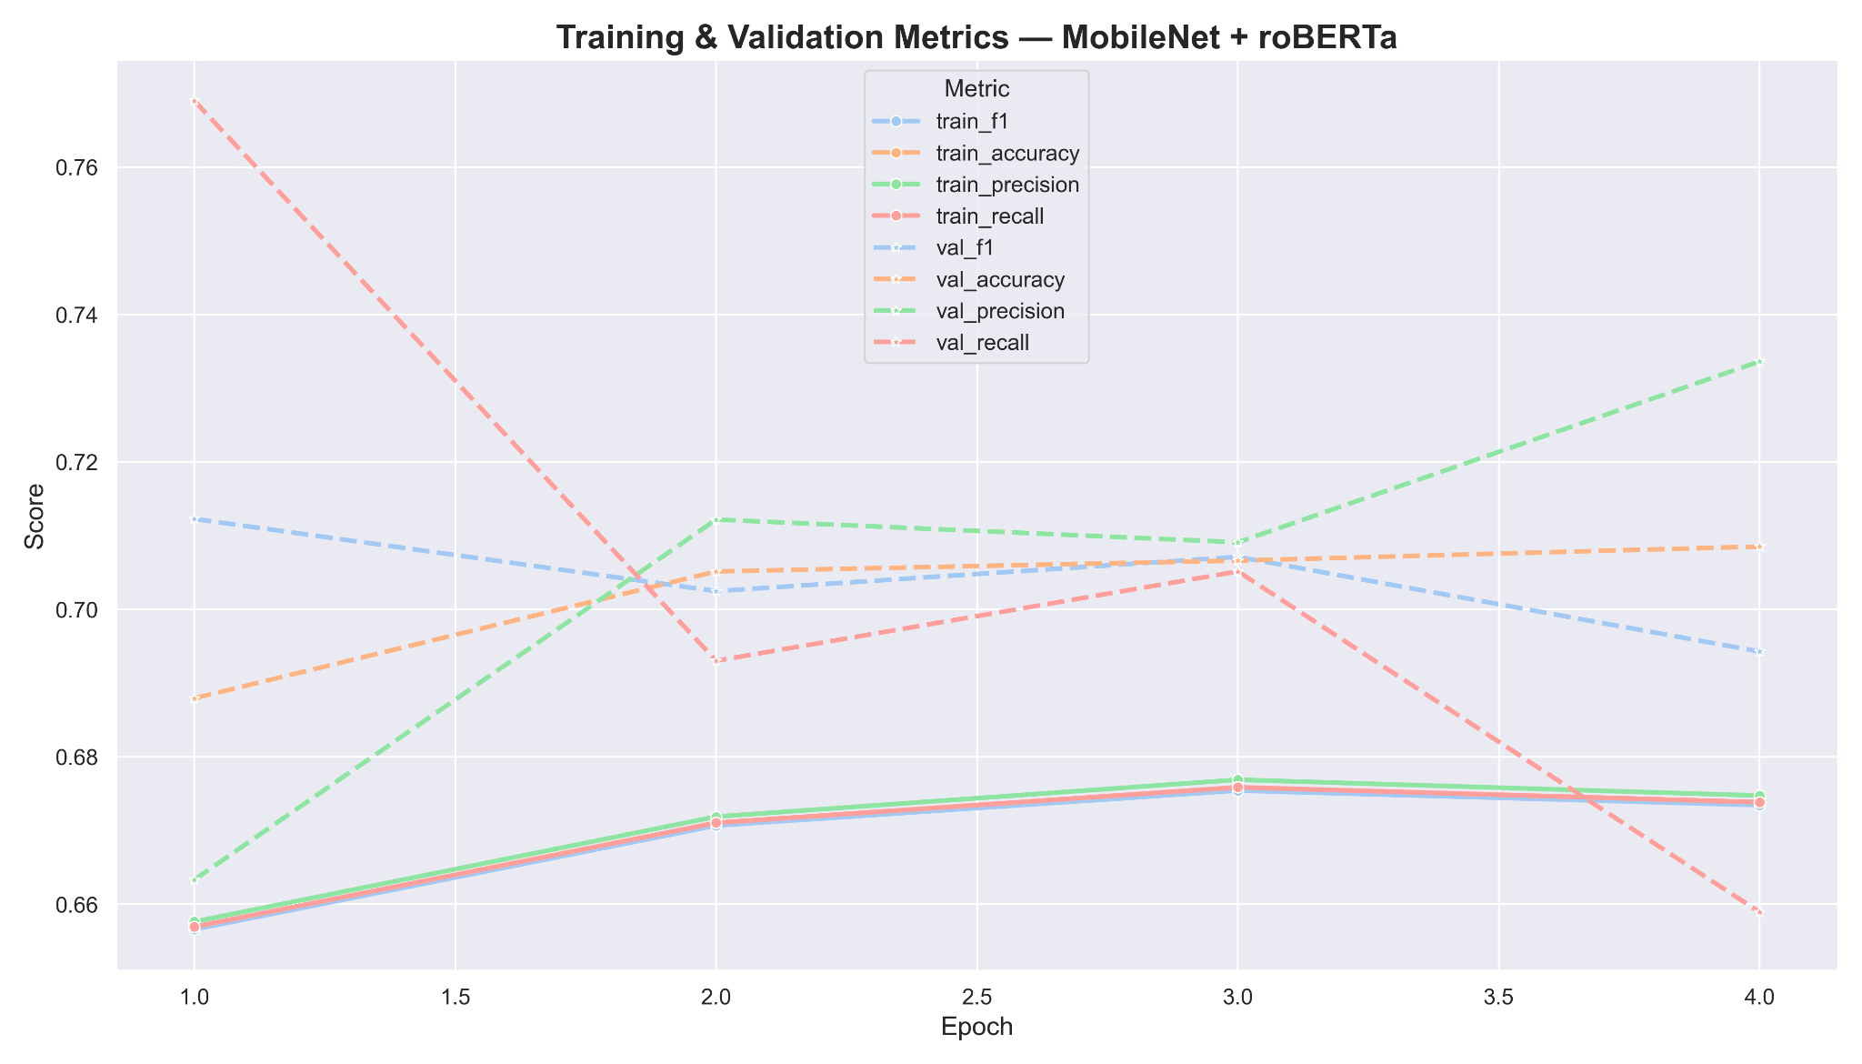
14.05.2025
NATIONAL UNIVERSITY OF SINGAPORE
MODELS - MobileNetV2 + RoBERTa
Metrics over different Alpha Values
Metrics with final alpha

Slide 14
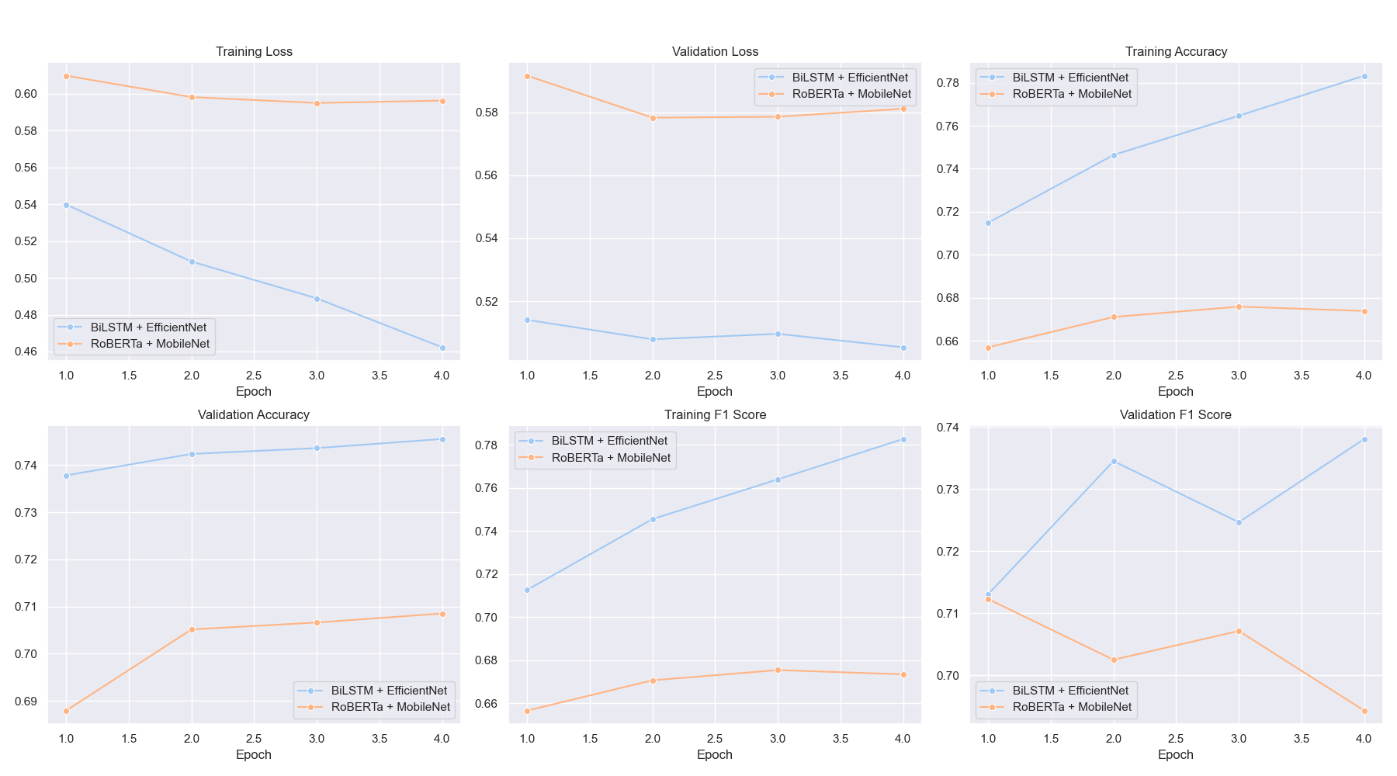
14.05.2025
NATIONAL UNIVERSITY OF SINGAPORE
MODELS - Comparison
Notes:
RoBERTA mobilenet model did not perform very well despite tuning an alpha parameter across epochs compared to bilstm efficientnet model.

Slide 15
14.05.2025
NATIONAL UNIVERSITY OF SINGAPORE
EVALUATION AND RESULTS
EfficientNet + BiLSTM
 | Precision | Recall | F1-Score | Support
NotHate | 0.72 | 0.71 | 0.72 | 22559
Hate | 0.72 | 0.73 | 0.72 | 22441
Accuracy |  |  | 0.72 | 45000
Macro Avg | 0.72 | 0.72 | 0.72 | 45000
Weighted Avg | 0.72 | 0.72 | 0.72 | 45000
Final Test Metrics:
Accuracy: 0.7206 F1: 0.7217 Precision: 0.7171 Recall: 0.7263

Slide 16
14.05.2025
NATIONAL UNIVERSITY OF SINGAPORE
EVALUATION AND RESULTS
MobileNetV2 + RoBERTa
 | Precision | Recall | F1-Score | Support
NotHate | 0.68 | 0.76 | 0.72 | 22559
Hate | 0.73 | 0.65 | 0.69 | 22441
Accuracy |  |  | 0.70 | 45000
Macro Avg | 0.71 | 0.70 | 0.70 | 45000
Weighted Avg | 0.71 | 0.70 | 0.70 | 45000
Final Test Metrics (after alpha tuning):
Accuracy: 0.7050 F1: 0.6862 Precision: 0.7307 Recall: 0.6469

Slide 17
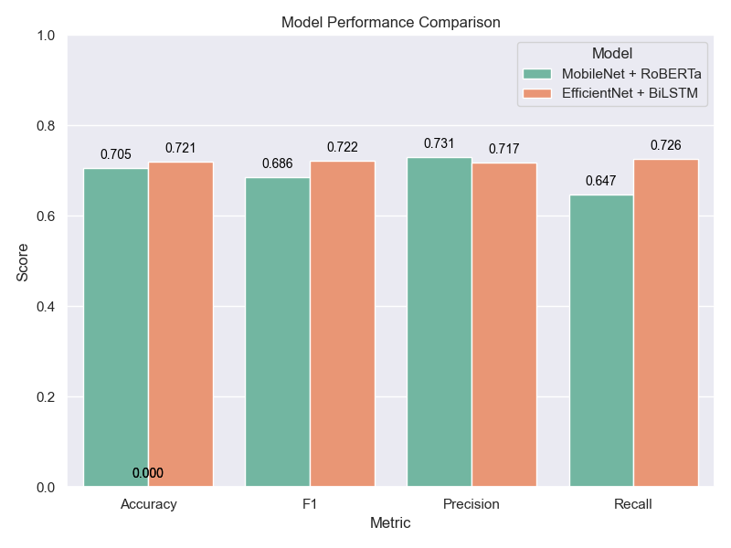
14.05.2025
NATIONAL UNIVERSITY OF SINGAPORE
EVALUATION AND RESULTS
Static Fusion (Alpha-weighted sum):
RoBERTa + MobileNet combined features using a fixed α * image_feature + (1 - α) * text_text.
This doesn’t allow the model to dynamically decide which modality is more important per sample.
In contrast, BiLSTM + EfficientNet had a fully connected fusion layer, allowing learned interactions between modalities rather than static weighting.
Shallow Fusion Layer:
Final prediction based on a single linear layer.
Less expressive than the deeper, multi-layer fusion in BiLSTM + EfficientNet.
Text Representation:
RoBERTa uses only the [CLS] token, which may not capture full sentence semantics.
BiLSTM considers the entire sequence context.

Slide 18
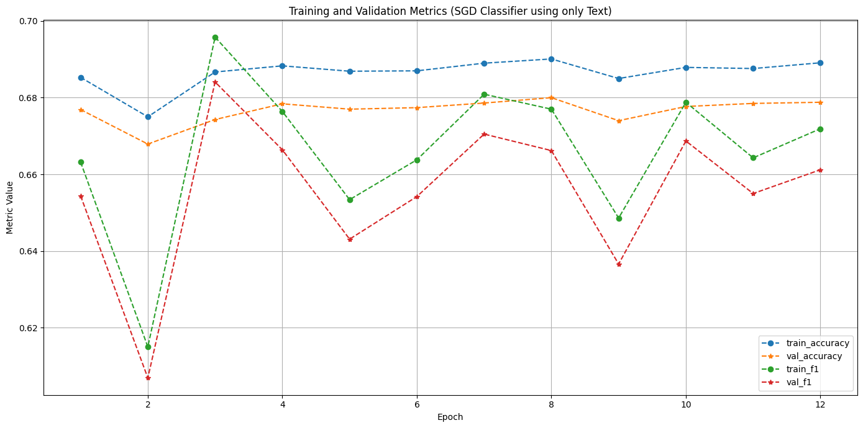
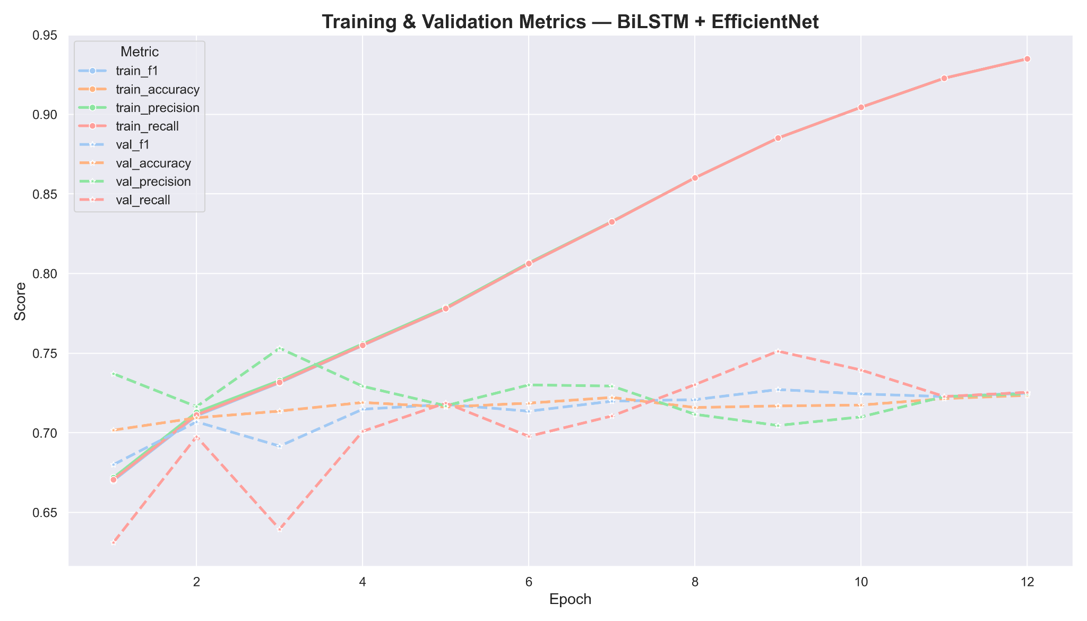
14.05.2025
NATIONAL UNIVERSITY OF SINGAPORE
COMPARISON - Text vs MultiModal
Output using Only Text
Output using MultiModal Model
On Test Data:
Accuracy: 0.6791
F1 Score: 0.6590
On Test Data:
Accuracy: 0.7134
F1 Score: 0.6921
Notes:
The objective was to use multimodal data but we wanted to compare with just text as well.

Slide 19
14.05.2025
NATIONAL UNIVERSITY OF SINGAPORE
RESULTS
Multimodal Advantage: The fusion of image and text modalities significantly outperforms text-only models. The best multimodal model (EfficientNet + BiLSTM) achieved an F1-score of 0.6921 vs. 0.6590 from the text-only baseline.
Model Comparison:
EfficientNet + BiLSTM showed superior performance across almost all metrics—Accuracy (0.7206), F1 (0.7217), Recall (0.7263)—making it the most balanced model.
MobileNetV2 + RoBERTa had slightly higher precision on the Hate class (0.73) but lower recall (0.65), leading to an overall lower F1 (0.6862) despite alpha tuning.
Fusion Strategy Impact: In the MobileNetV2 + RoBERTa model, tuning the α parameter helped balance the contributions of text and image features. However, even with optimal α (≈0.75), performance remained behind EfficientNet + BiLSTM.
Generalization Ability: EfficientNet + BiLSTM demonstrated more consistent validation and test performance, with better convergence across epochs, indicating stronger generalization and robustness to overfitting.

Slide 20
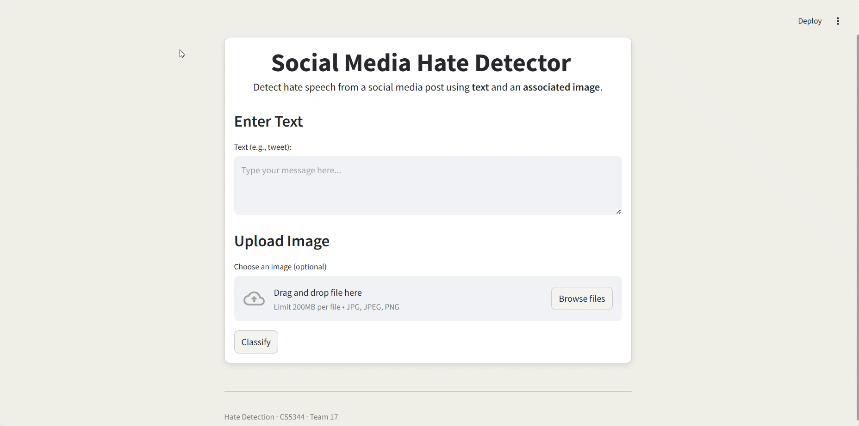
14.05.2025
NATIONAL UNIVERSITY OF SINGAPORE
DEMO

Slide 21
14.05.2025
NATIONAL UNIVERSITY OF SINGAPORE
CONCLUSION AND FUTURE WORK
Used MMHS150K Dataset
150,000 image–text pairs from Twitter, labeled across multiple hate categories.
Best performing multi-modal model:
EfficientNet + BiLSTM
Accuracy - 72.06%
F1 Score - 72.17%
Multimodal models outperformed text-only models
Combining image and text features significantly boosted classification performance over text-only models.
Original paper claims that just textual models perform better than multimodal models, however as shown by our analysis and experiments, with the right model architecture and fine tuning, it is possible to get better results than with just text data.
In future work, we can further tune and train these models to improve their metrics.

Slide 22
14.05.2025
NATIONAL UNIVERSITY OF SINGAPORE
REFERENCES
Dataset Link
Original Paper Link
Our github repository

Slide 23
CYMBAL
PRODUCT OVERVIEW
THANK YOU
GROUP 17
14.05.2025
NATIONAL UNIVERSITY OF SINGAPORE

